Slide 1
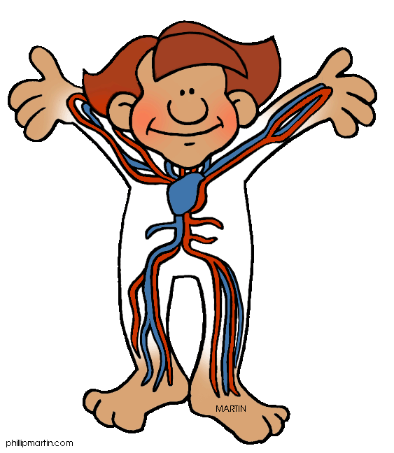
Human Body System

Slide 2
Lesson Goals

Slide 3
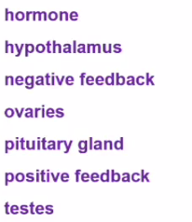
Words to Know-Add
Add to E-Notes and Look up in Glossary

Slide 4
How does body response to stimuli?
Main Function of the Nervous System
Two Parts of Nervous System

Slide 5
Human Body Systems
Identify the Part of the Nervous System

Slide 6
Parts of a Neuron

Slide 7
Parts of Neuron

Slide 8
Process of Stimulus Response

Slide 9
Endocrine System

Slide 10
Endocrine System

Slide 11
Identify the Glands

Slide 12
Endocrine System

Slide 13
Endocrine System

